Slide 1

Eye Tracking Analysis Of Creative Advertisement Using GazeRecorder
Vishal Ubnare
Department of Cognitive and Brain Sciences, IIT Gandhinagar

Slide 2
Contents
Slide No.
INTRODUCTION .……………….3
AD-1 Voltaren Pain Relief .……………….4
AD-2 Hammer Headache ………………..6
AD-3 Expired Wardrobe ………………..8
AD-4 Avia Motor Oil ……………….10
AD-5 Café Jet Wakeup ……………….12
AD-6 Crime Stoppers Parrot ……………….14
REFERENCES ………………..16

Slide 3
Introduction
This study investigates how viewers visually engage with creative advertisements using eye-tracking technology.
Using GazeRecorder, I analysed participants' recorded eye movements from the Dataset as they viewed six visually distinct advertisements.
Each ad incorporated creative, unexpected, or humorous elements designed to capture attention. Further, I manually defined specific Areas of Interest (AOIs) within each ad and examined viewer gaze behaviour within these regions to uncover both quantitative and qualitative insights.

Slide 4
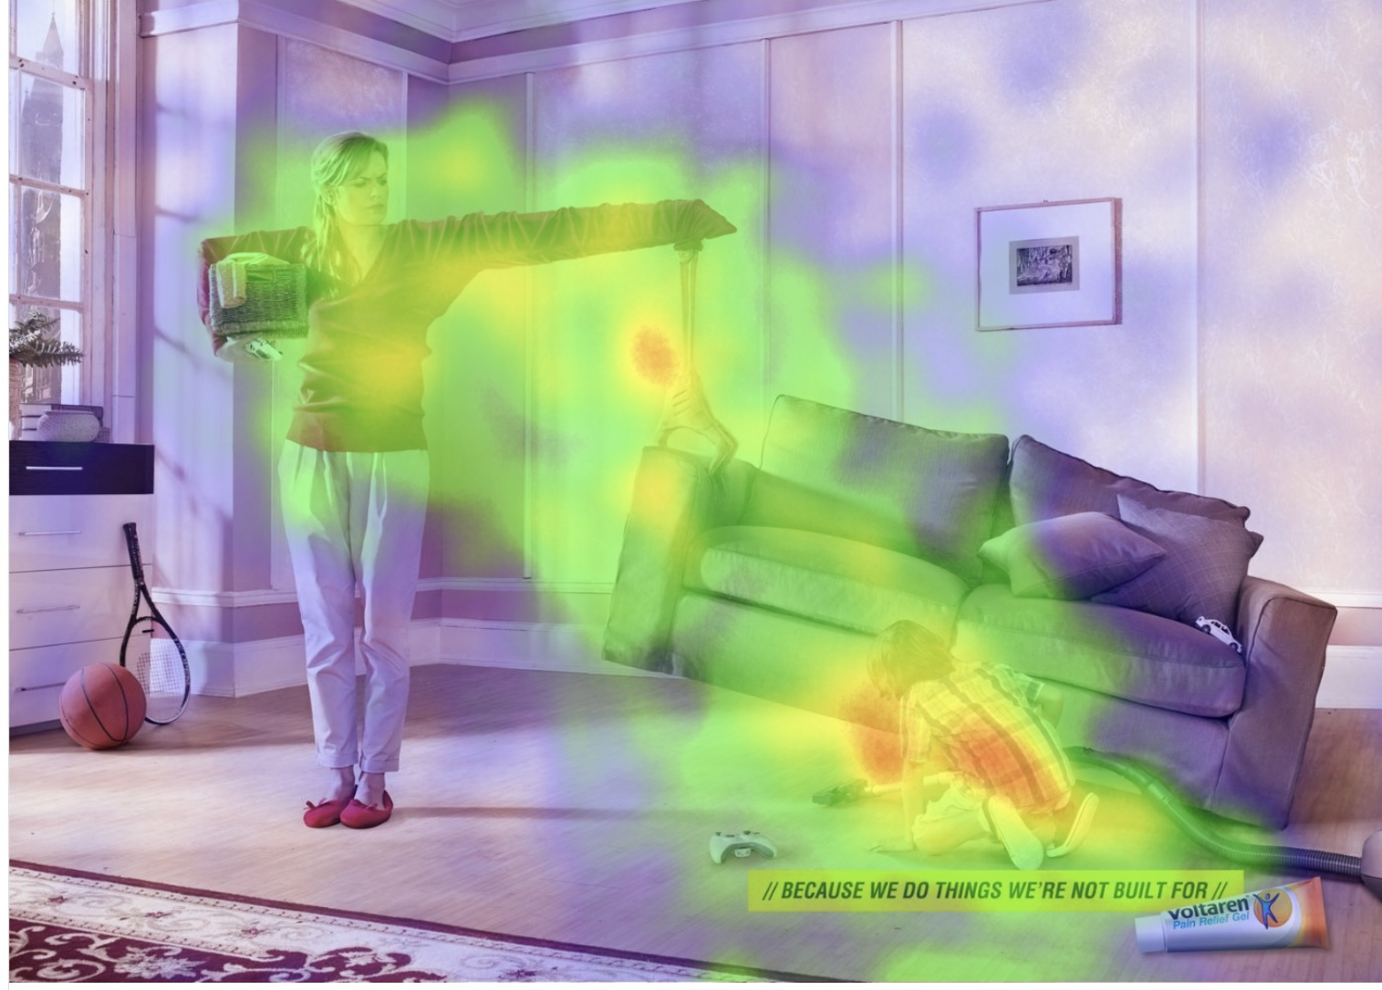
AD-1 name: Voltaren Pain relief
Interpretation The ad's creativity effectively drew attention to the central tension (arms stretch), indirectly linking it to pain relief. Product visibility is moderate, suggesting improved placement might aid recall.

Slide 5
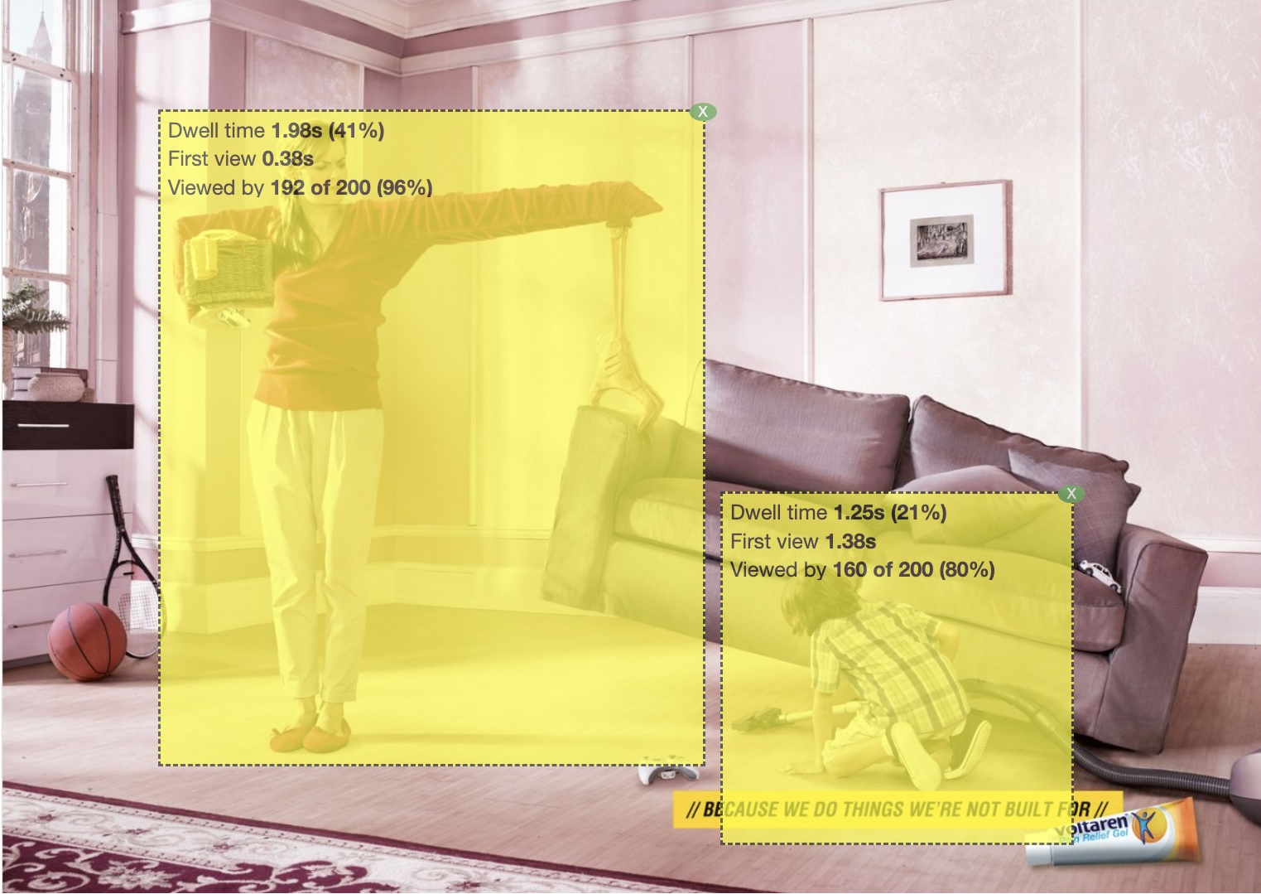
AOI | First View (s) | Dwell Time (s) | Viewed By (%)
1 | 0.38 | 1.98 | 96
2 | 1.38 | 1.25 | 80
High attention on the stretching arm and child. The product and slogan attracted notable but slightly lesser gaze.
AOI 1 (Stretching woman): Captured attention first and most intensely. The exaggerated posture made it the visual anchor.
AOI 2 (Product + tagline + child): Noticed later. While relevant, it competed with emotional and humorous content for attention.
Results
Most viewers focused first on the exaggerated arm stretch, then moved to the child and finally to the product.
The extended arm was the primary fixation point. Attention then shifted to the child and the Voltaren product and tagline in the bottom-right.

Slide 6
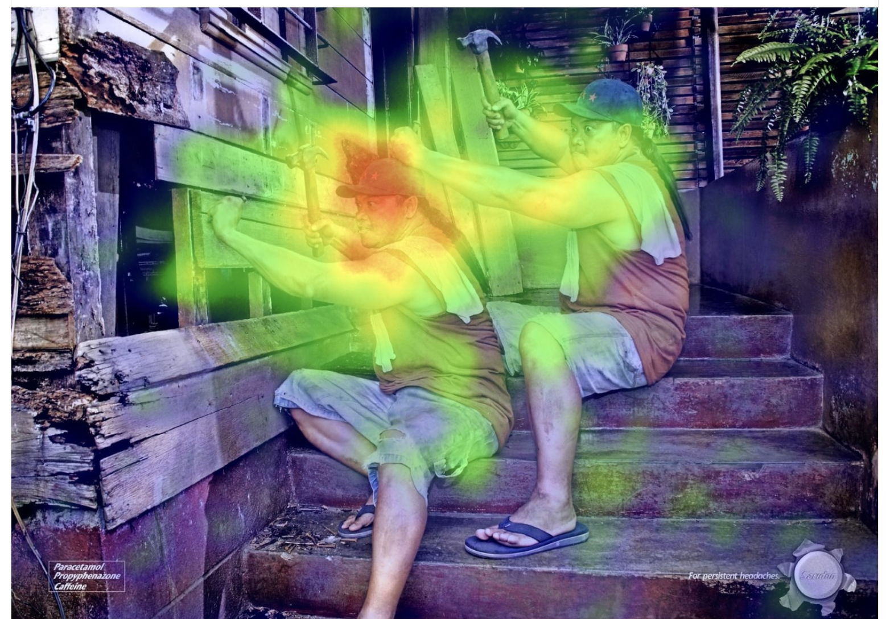
Ad-2 name: Hammer Headache
Interpretation
The representation for headache was clear and visually engaging, but the duplicated character may create confusion. It depicts how a headache feels and to resolve that there is medicine showed in the bottom right corner.

Slide 7
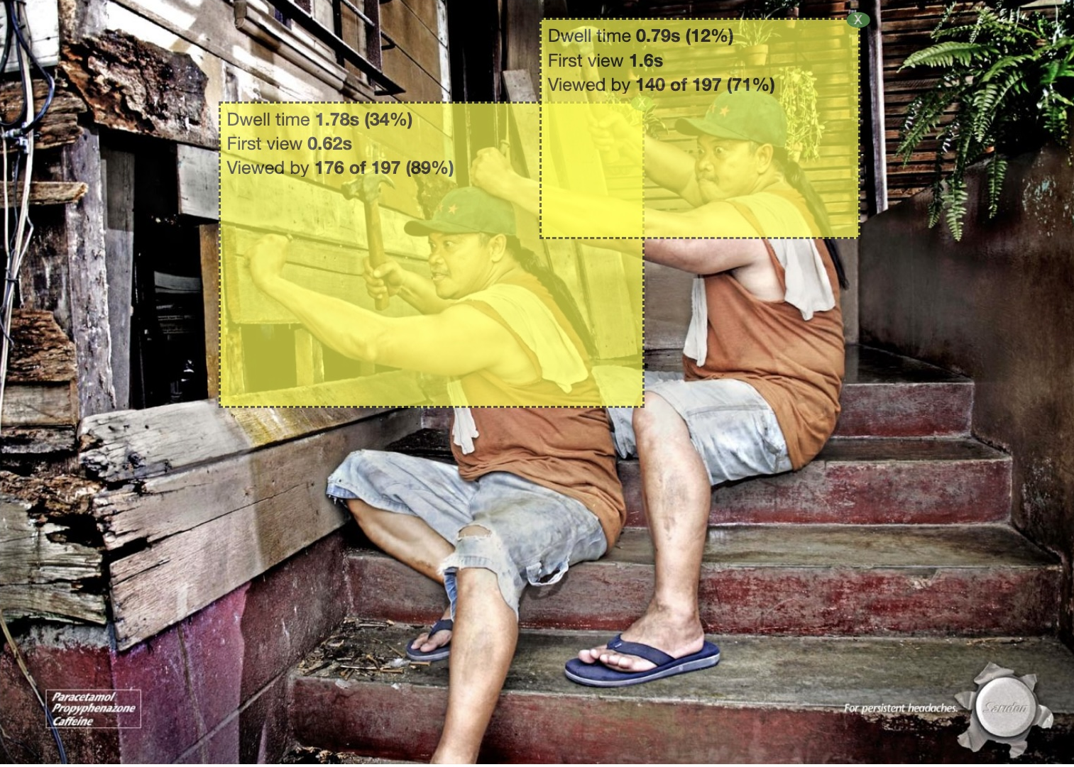
AOI | First View (s) | Dwell Time (s) | Viewed By (%)
1 | 0.62 | 1.78 | 89
2 | 1.6 | 0.79 | 71
High attention on the first guy who is knocking the nail in wood.
AOI 1 (First worker with hammer on head): Engaged strongly due to surprising visual metaphor.
AOI 2 (Second, mirrored worker): Received less attention—possibly due to symmetry being processed as redundant.
Results
Most people noticed the man with the hammer quickly and focused on him longer.
The reflection of same man was noticed later and got less attention.

Slide 8
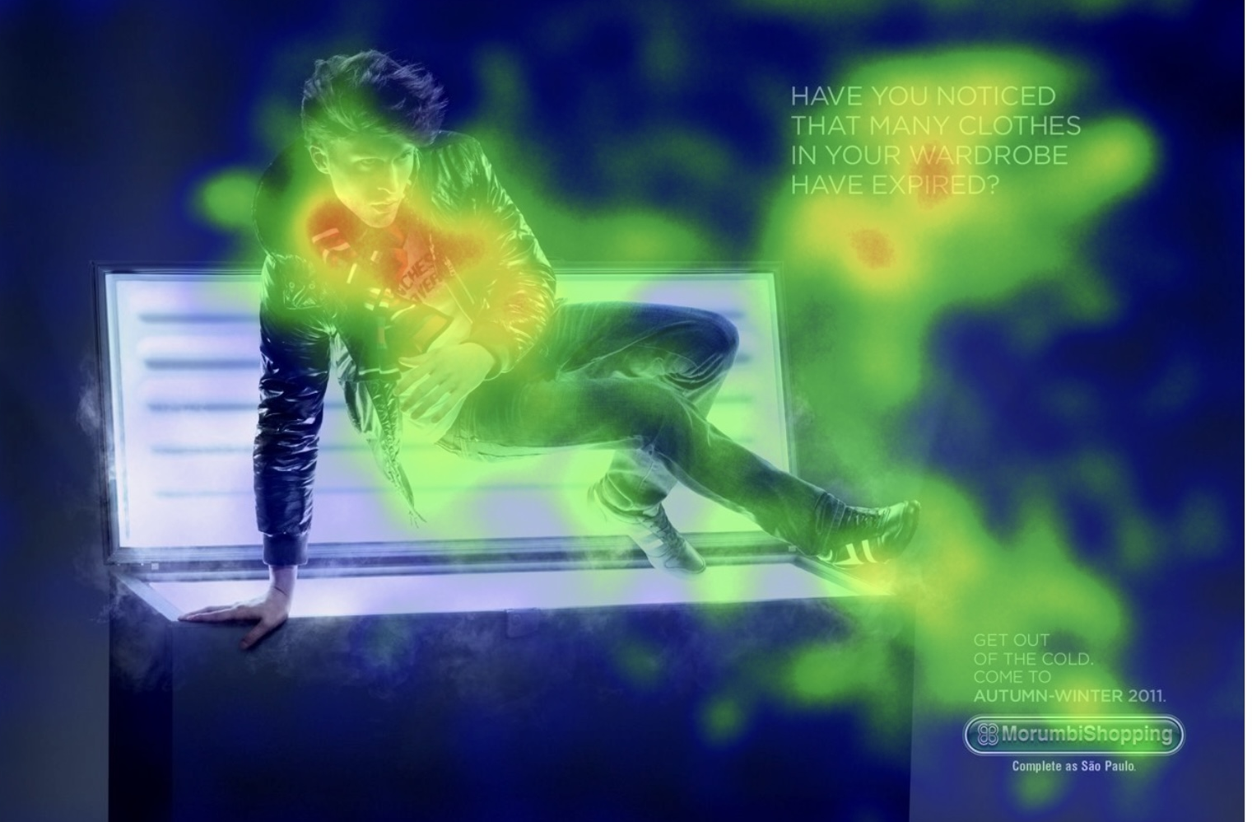
AD-3 name: Expired Wardrobe
Interpretation
The image shows a man jumping out of a freezer, wearing stylish winter clothes. The text asks if your clothes are old or “expired,” like food in a fridge.
It suggests it's time to update your wardrobe and invites you to shop for the new Autumn-Winter collection at Morumbi Shopping.

Slide 9
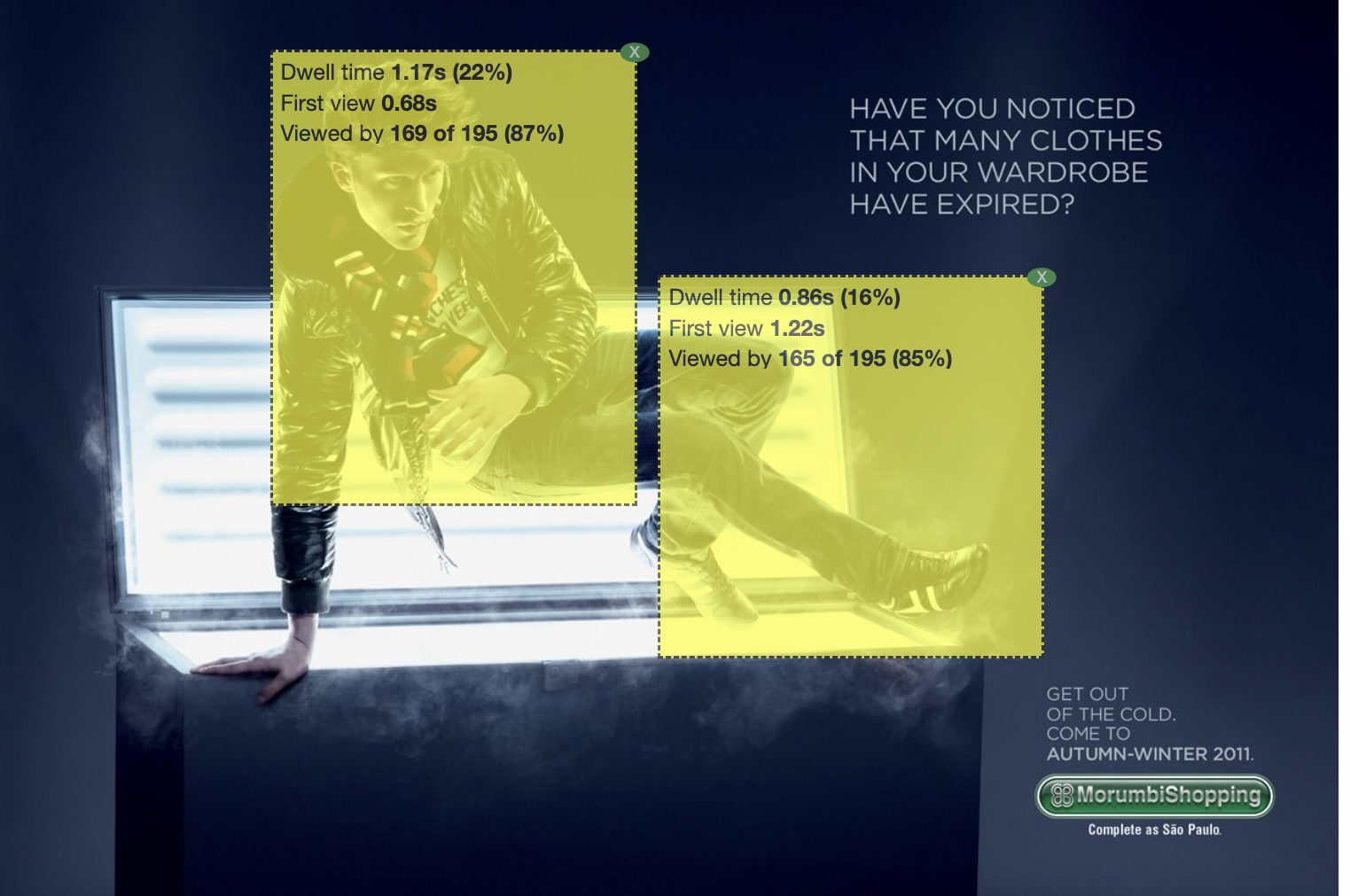
AOI | First View (s) | Dwell Time (s) | Viewed By (%)
1 | 0.68 | 1.17 | 87
2 | 1.22 | 0.86 | 85
AOI 1 (Model’s face and upper body): Drew initial attention due to central placement and facial salience.
AOI 2 (Tagline and logo at lower corner): Received attention but not immediately. Viewers processed the visual joke first before noticing the message.
Results The man and the freezer-wardrobe were the first areas fixated upon, The upper body was noticed earlier and held longer attention than the lower body.
The face and upper clothing captured viewers’ eyes first, reflecting a natural tendency to look at faces and detailed clothing.
the lower body was still widely seen, it received less focus overall.

Slide 10
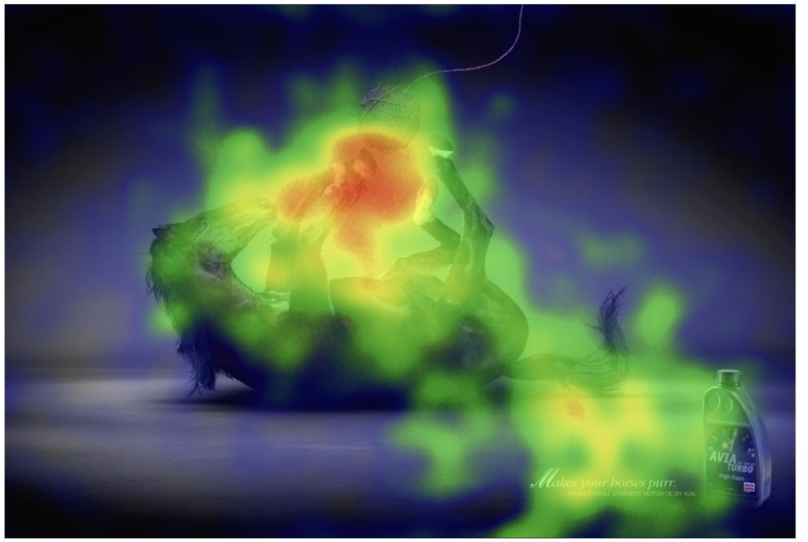
AD-4 name:AVIA Motor Oil
Interpretation
The image shows a horse playing like a cat with a ball of yarn. This is unusual and funny. It is an ad for motor oil.
The message is this oil is so smooth, it makes your engine (“horsepower”) as soft and quiet as a cat. The line says, "Makes your horses purr."

Slide 11
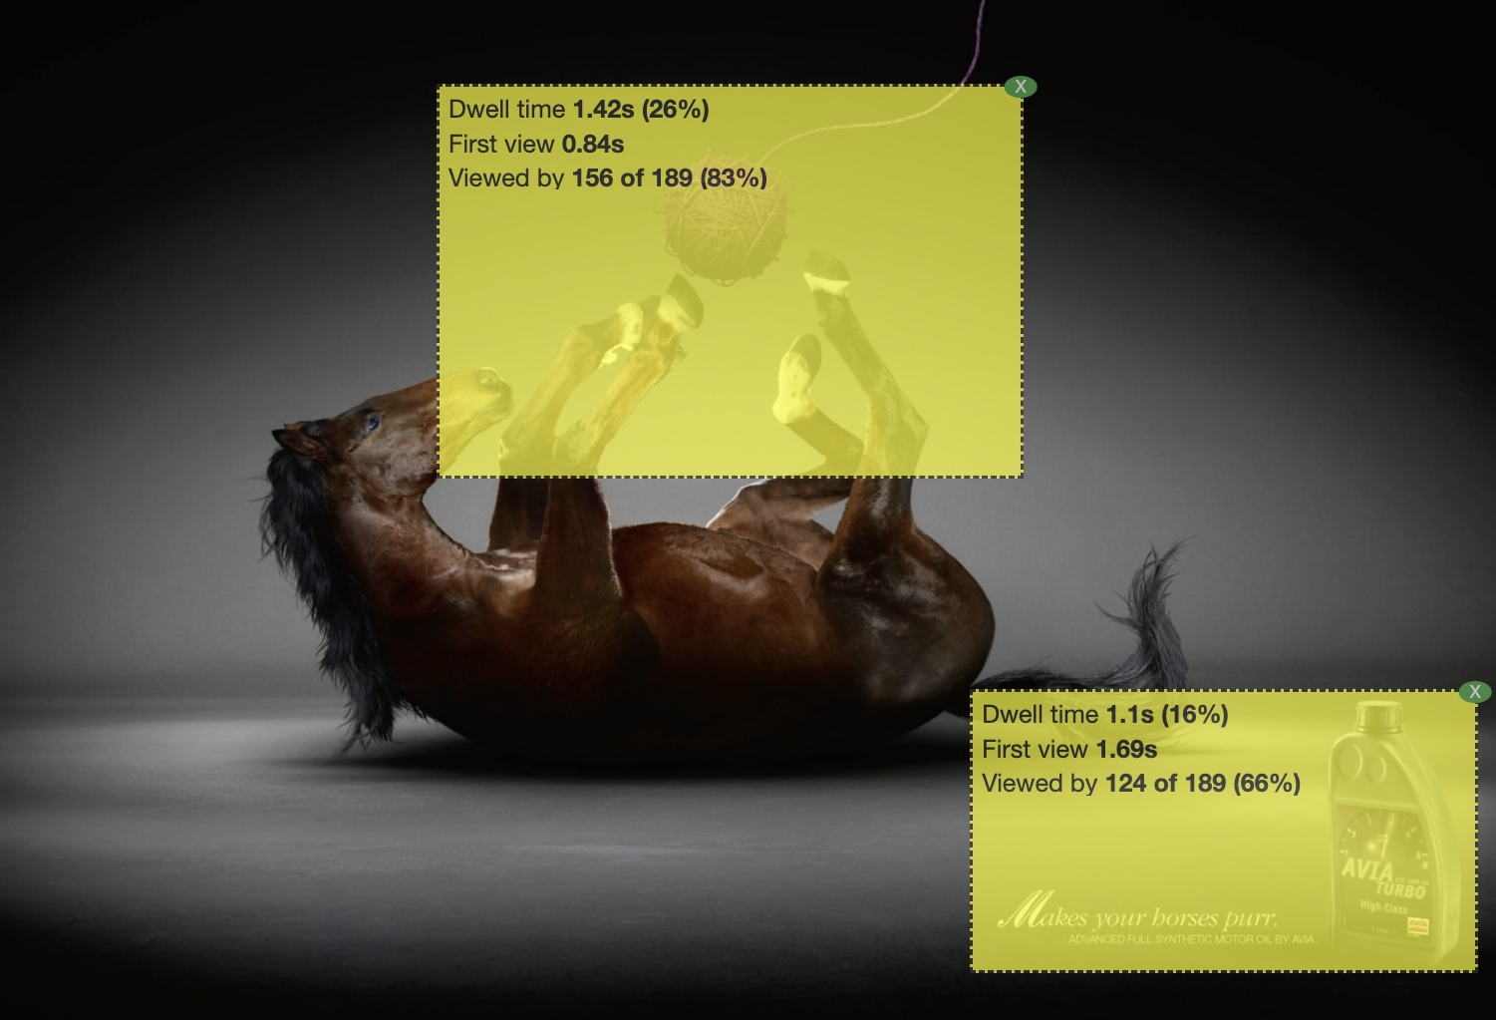
AOI | First View (s) | Dwell Time (s) | Viewed By (%)
1 | 0.84 | 1.42 | 83
2 | 1.69 | 1.1 | 66
AOI 1 (Horse on its back): Most people looked at the horse first. It got more attention because it looked unusual and was in the center.
AOI 2 (Product and slogan): Fewer people looked at the product and words in the corner. The horse kept most of the attention.
Results
People mostly focused on the horse lying on its back, as it appeared large, unusual, and was placed in the center, making it the main point of interest.
The product and slogan in the corner received less attention, as viewers were more drawn to the surprising and eye-catching image of the horse.

Slide 12
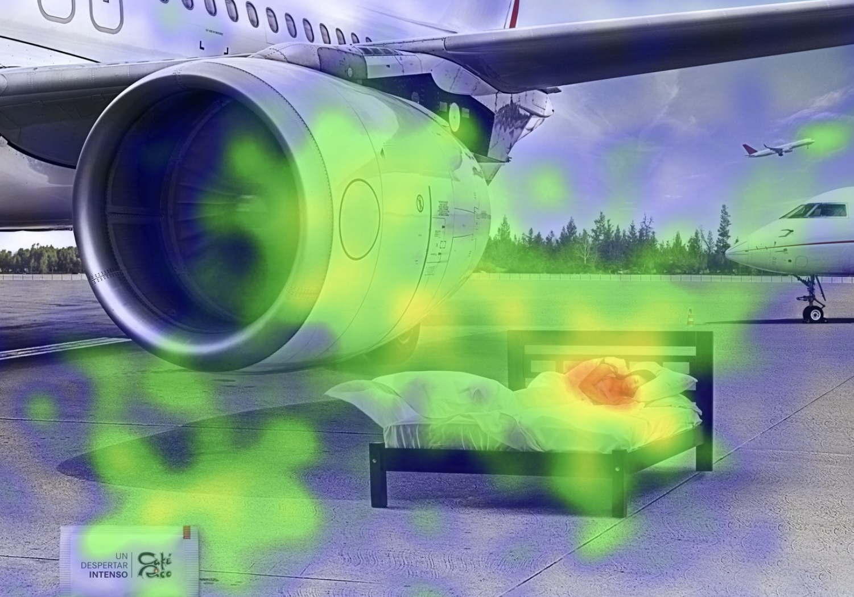
AD-5 name:Café Jet Wakeup
Interpretation
The jet engine and person in bed grabbed attention, showing the ad’s unusual imagery, which worked well. However, the product packet was overlooked, and while viewers enjoyed the humour, A small packet in the corner labelled “Un Despertar Intenso” (Spanish for “An Intense Awakening”) suggests the product is a strong coffee.

Slide 13
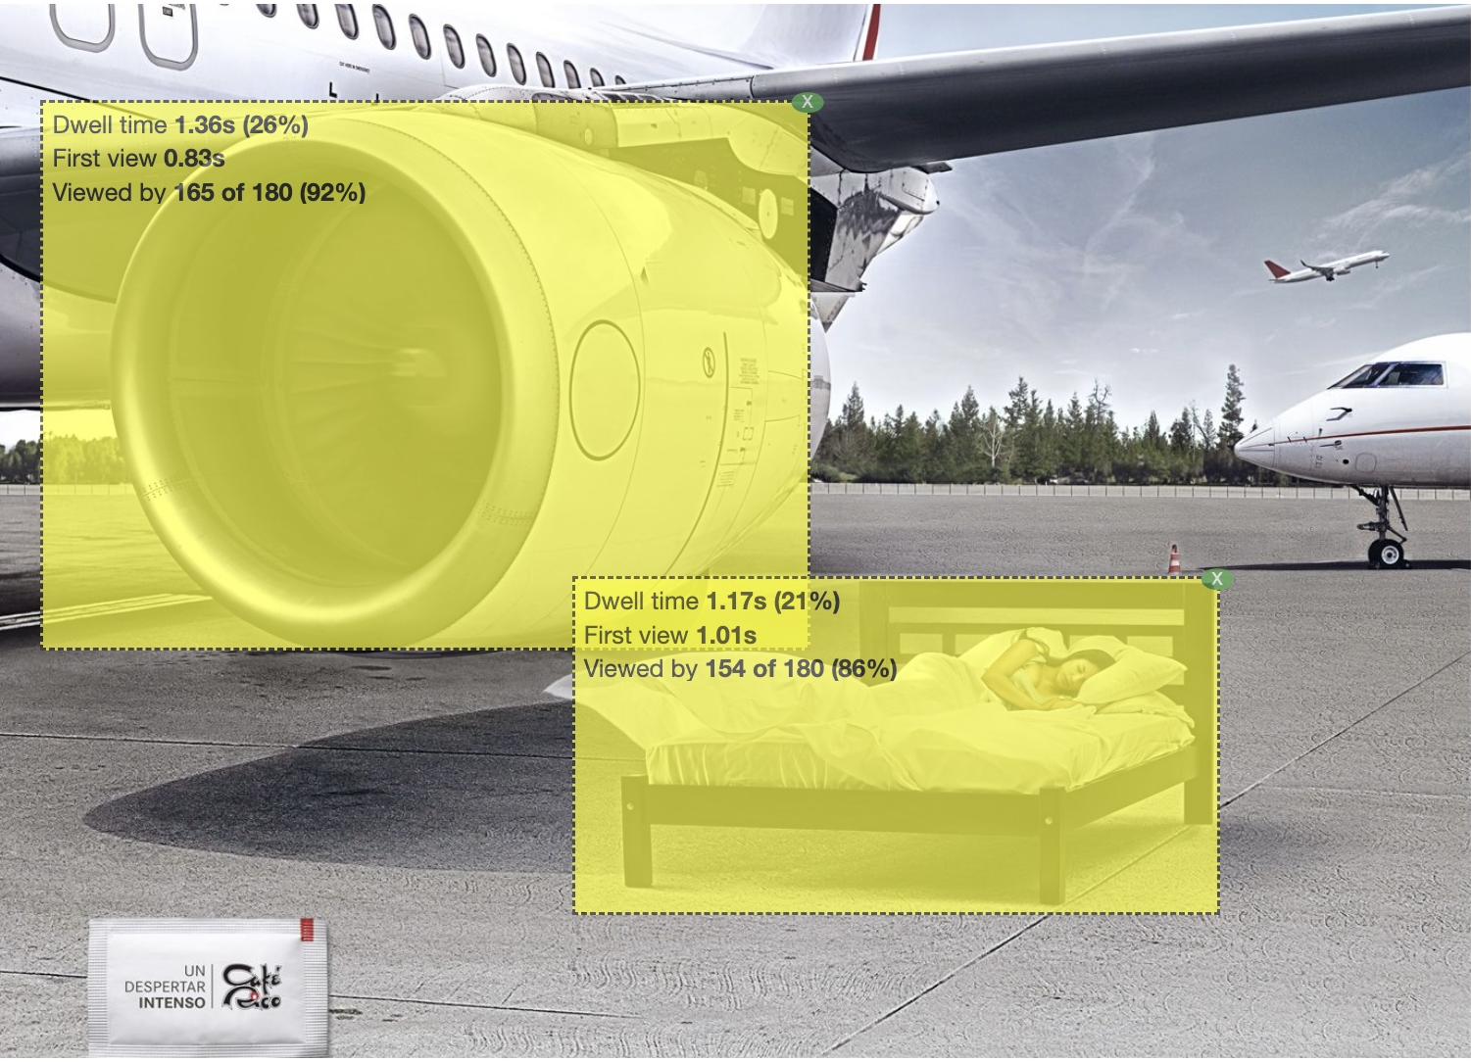
AOI | First View (s) | Dwell Time (s) | Viewed By (%)
1 | 0.83 | 1.36 | 92
2 | 1.01 | 1.17 | 86
AOI 1 (Jet engine near the bed): High visual salience, triggering immediate fixation due to absurdity.
AOI 2 (Coffee packet): Less attention despite being the product. Viewers may interpret the ad without needing to look at the brand explicitly.
Results
Most people first look at the aeroplane engine, likely because it is large, detailed, and takes up a big part of the picture.
The bed with the sleeping person also got much attention, but slightly less than the aeroplane.
The unusual combination of an aeroplane and a bed in the same scene made the image interesting, but the big and bold engine grabbed attention a little more than the smaller bed.

Slide 14
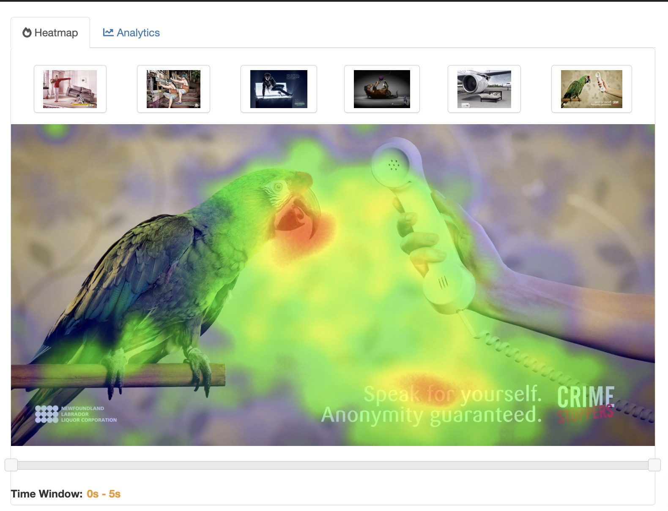
AD-6 name:Crime Stoppers Parrot
Interpretaion
The image shows a parrot and a person holding a phone. Parrots repeat what they hear, but the message says
"Speak for yourself. Anonymity guaranteed." It means you can report a crime safely and your identity will stay secret.

Slide 15
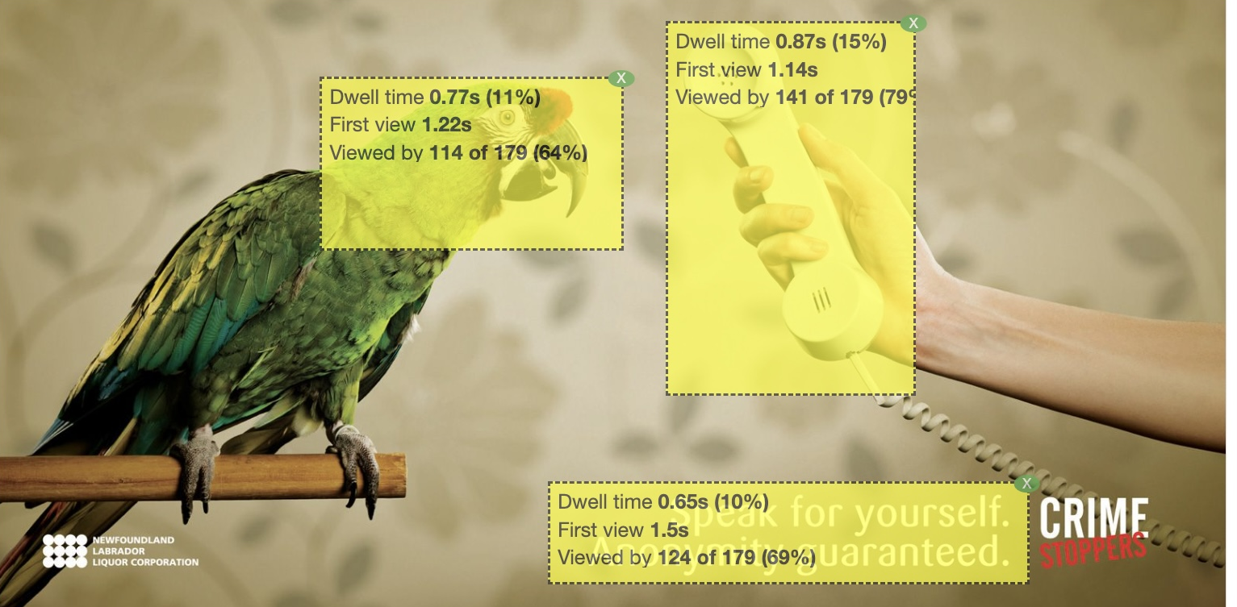
AOI | First View (s) | Dwell Time (s) | Viewed By (%)
1 | 1.22 | 0.77 | 64
2 | 1.14 | 0.87 | 79
3 | 1.5 | 0.65 | 69
AOI 1 (Parrot): Attracted attention due to bright color and unusual presence.
AOI 2 (Phone receiver/hand): Highest dwell time—possibly because it's an action-related cue.
AOI 3 (Text): Received moderate attention, as viewers scanned for context.
Results
Viewers focused most on the hand holding the yellow phone, likely because of its bright color and central position.
The parrot also drew attention but was not as eye-catching as the phone.
The text at the bottom received the least focus, suggesting that people were more interested in the main visuals than reading the message.

Slide 16
References
GazeRecorder | Cloud Eye-Tracking Insights Platform. (n.d.). Retrieved April 13, 2025, from https://app.gazerecorder.com/Study/?demo&StudyID=study_e5c922b7-f605-45db-946c-4f785731a664

